Slide 1
Lecture 6
Data Center
Instructor : Engr. Tehmeed

Slide 2
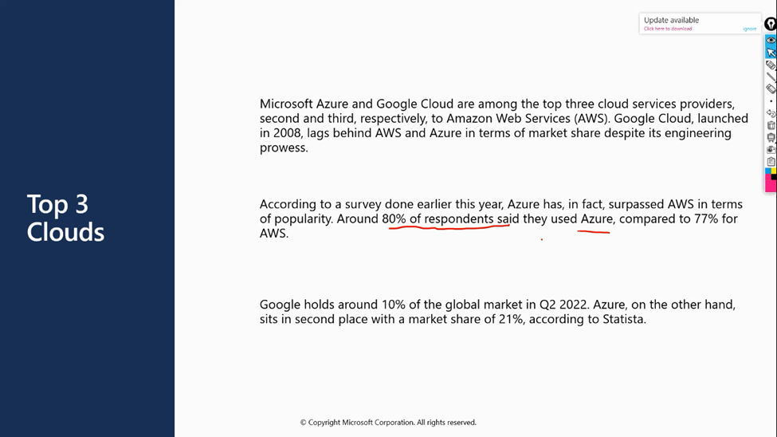

Slide 3
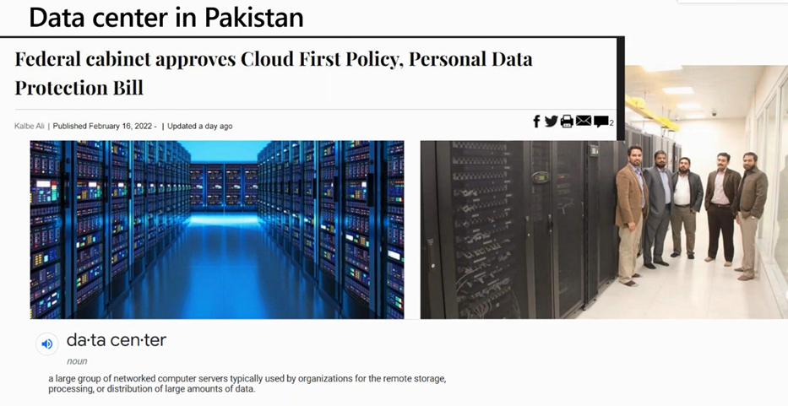

Slide 4
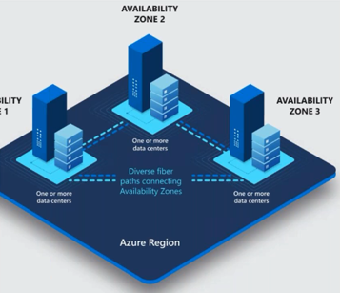

Slide 5
Data Center:
At its simplest, a data center is a physical facility that organizations use to house their critical applications and data. A data center's design is based on a network of computing and storage resources that enable the delivery of shared applications and data. The key components of a data center design include routers, switches, firewalls, storage systems, servers, and application-delivery controllers.

Slide 6
Azure Region:
An Azure region consists of one or more datacenters, connected by a high-capacity, fault-tolerant, low-latency network connection. Azure datacenters are typically located within a large metropolitan area. Every region is contained within a single geography that serves as a fixed data residency boundary.

Slide 7
Azure Zone:
A zone is a deployment area for Azure Cloud resources within a region. Zones should be considered a single failure domain within a region. To deploy fault-tolerant applications with high availability and help protect against unexpected failures, deploy your applications across multiple zones in a region.

Slide 8
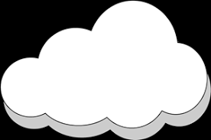
Any Questions ?

